Slide 1

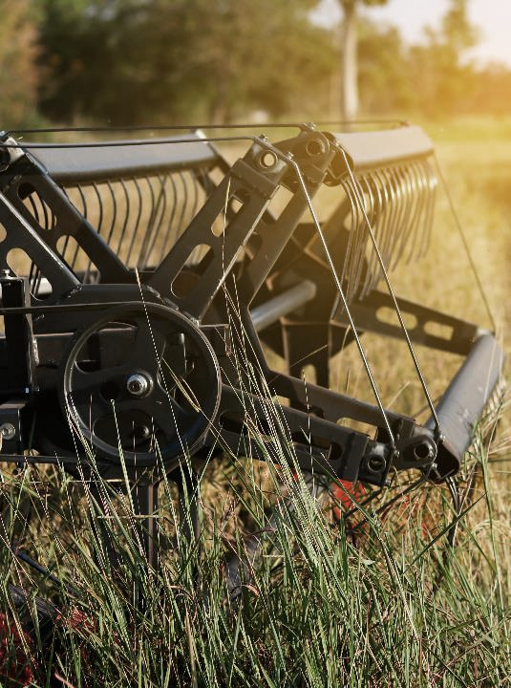
CASTINGS
Your One Stop Shop
Our casting partners have been producing and supplying high-quality aluminum castings for over 30 years.
We use cutting-edge production methods and in-house processes to ensure superior quality, on-time delivery, and cost-effectiveness.
We enjoy the privilege of supplying our products to market leading OEMs and dealers in over 30 countries spanning 6 continents.

Slide 2
Picking the Right Material for
Your Spring Requirements
.
Compression, torsion and extension springs are frequently made using steel wires of grades A228, A229, and A401.
Let our engineering team help you choose the best material for your application.
A228
A229
A401
This material is a high-carbon steel with a tensile strength. It has good fatigue resistance and elastic properties, making it suitable for applications where the spring is subjected to repeated cycles of stress.
Oil-tempered high-carbon steel wire is stronger and harder than A228 but more brittle. It is commonly used for springs that require bending or twisting to fit a specific shape. The content is informative and error-free.
Oil-tempered high-carbon steel wire is stronger and harder than A228 but more brittle. It is commonly used for springs that require bending or twisting to fit a specific shape. The content is informative and error-free.

Slide 3
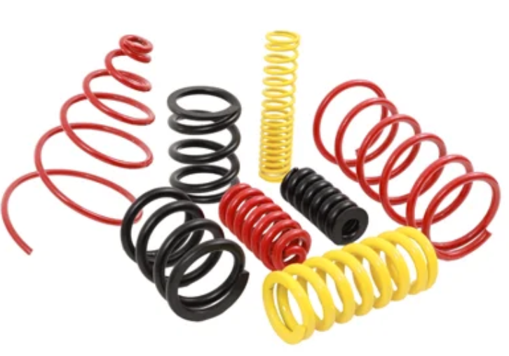
Aluminum Castings
Our compression springs, engineered to store energy under compressive forces, hold a key place across a spectrum of industries.
We are a preferred supplier to customers seeking durable & top-tier compression springs. Essential for automotive suspensions, engine valves, clutches & more, these springs integrate versatility with longevity.
Crafted from premium wire: We only use the highest quality wire, ranging from 0.025” to 0.63”, ensuring optimal performance for your specific application.
Custom-engineered for excellence: Our springs aren’t one-size-fits-all. We work closely with you to understand your unique needs & design springs that exceed your expectations.

Slide 4
Thank you for considering
as your next business partner!
Contact our team today
to hear how we can meet your casting needs!
Chris Arthur (229) 425-1538
Robert Bryant (229) 457-2042

